Slide 1

Smallest Palindrome Generator
Made By
BT23CSE045 – Aryan Yadav BT23CSE055 – Pragyan Kantiwal BT23CSE056 – Ayush Gautam BT23CSE061 – Aryan Mane
BT23CSE066 – Kovidhraj Kotegiri

Slide 2

So, What's the Big Idea?
Our Mission:
Take any string and add the shortest ending to make it a palindrome.
abc → abcba
race → racecar
Add "ba"
Add "car"
aba → aba
Already a palindrome!

Slide 3



Palindrome Generation: 6-Step TM Procedure
Let our word be 'w' and its reverse be 'w_rev’.
1. Startup & Quick Palindrome Check
The input word is placed on the tape and quickly checked to see if it is already a palindrome.
2. Copy Reverse into Safe Region
The machine scans the input from right to left, marking each letter and writing its lowercase copy into a distant safe region on the tape.
Make a reversed copy. race → ecar
3. Find the Longest Overlap
The TM compares the end of the original word with the start of the reversed copy to find the largest matching overlap. End of original matches beginning of reversed. race + ecar → raceecar (overlap 'e', k=1)

Slide 4

Palindrome Generation: 6-Step TM Procedure
Let our word be 'w' and its reverse be 'w_rev'.
4. Append the Remainder
The machine appends the non-overlapping portion of the reversed string directly after the input. Grab non-overlapping part of reversed word. ecar leftover is 'car' Result: race + car = racecar
5. Halt & Output
The TM enters its halt state, prints the completed palindrome, and logs the full tape trace.

Slide 5
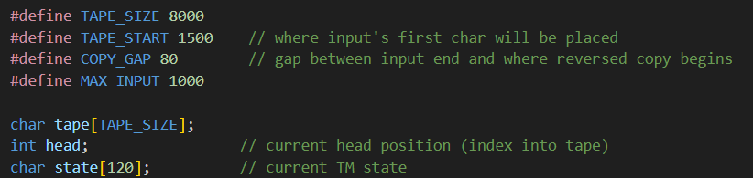
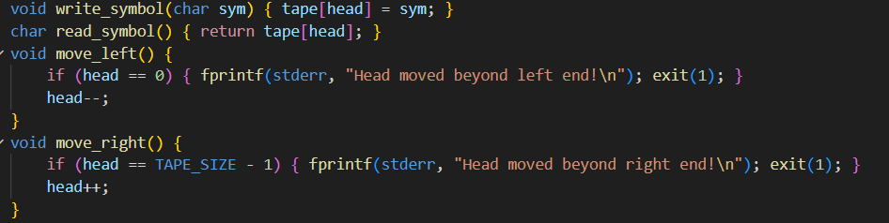
Key Components of the Code

Slide 6
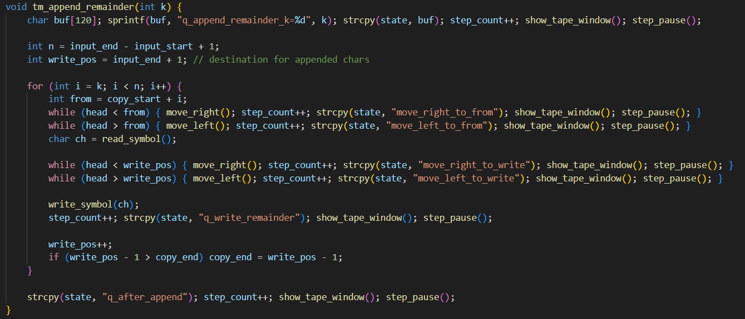
Key Components of the Code

Slide 7




The "Marking" Trick
How does it "remember" what it's doing?
Problem: TM has terrible memory when copying. Solution: Marking!
Expanded Alphabet
Example: abc → abC_
Uses uppercase letters to mark.
Mark 'c' as 'C'.
Copy & Mark
Write 'c', then mark 'b' as 'B'.
Uppercase acts as a second track that marks which letters are already processed.

Slide 8








Building with "Mini-Machines"
Complex Machines from Simple Parts
Functions in C code are TM Subroutines, like LEGO bricks.
M_start calls M_copy_reverse
M_copy_reverse calls M_find_overlap
"Go make a backwards copy."
"Find the biggest match."
M_find_overlap calls M_append
M_append calls M_halt
"Aaaand... stop. Done!"
"Copy leftover letters."

Slide 9


What's the Big Takeaway?
What We Learned
It's Solvable!
Code is an Algorithm
Problem is decidable/computable; TM can solve it and stops.
C code is a clear, step-by-step recipe for the TM.
Cool TM Tricks
All the Same Power
Marking (uppercase/lowercase as checkbox)
Done with a simple single-tape machine, no fancier machine needed!
Subroutines (chaining mini-machines)
Shuttling (bouncing back and forth)

Slide 10

Questions?

